Slide 1
Team 4: Airmazing

Slide 2
The Team and sub-groups
Airmazing
Team Leader: Ruxandra Panainte
Sub-groups
Implementation Research Project Management
- Sam Payne (Lead)
Andreas Milhaloianis
Andrei Nica
Kirthi Muralikrishnan
Megane Martinez
Vino Mano
Ruxandra Panainte (Lead)
Abraham Olaoye
Elaine M’Nkubitu
Johan Mouritsen
Tom Page
Danyaal Masood (Lead)
Gergana Marincheva
Sarjeena Maodud

Slide 3
Goals
Airmazing
Aim: To reduce the day-to-day negative impact of pollution on people, esp. those with respiratory conditions
Primary Goals:
Predict pollution levels for next 24 hours to allow users to make a choice about their route to work or whether or not to attend
Record the user's usual route to work and ‘rate’ their potential exposure to pollution for that work-day in a single index
Gather daily feedback data in the form of a 1-5 user rating
Secondary Goals:
Alert the user if pollution levels are likely to affect them during the following work-day.
Calculate a range of alternate routes for user to reduce impacts of pollution on their commute

Slide 4
Benefits
Airmazing
People will be aware of the detrimental effects of air pollution that are often overlooked and they will be able to reduce their exposure
People with respiratory conditions will be able to prevent further worsening of their conditions
Challenges
Gathering weather and pollution data to make predictions
Involving traffic levels into predictions
Creating an accurate predictive model and testing it
Opportunities
Prediction is not used in the majority of mobile applications
Feedback and application personalization

Slide 5
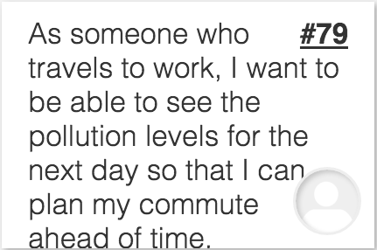
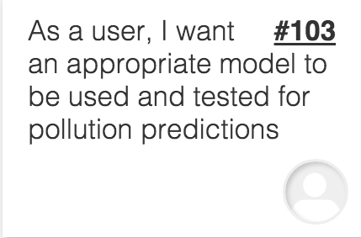
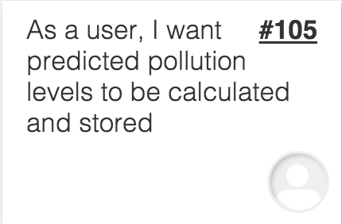
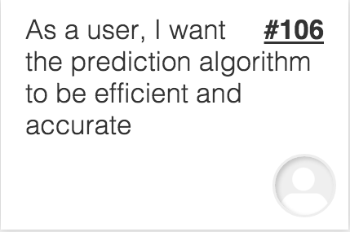
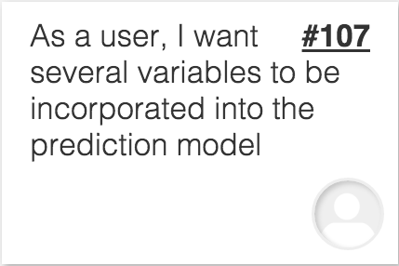
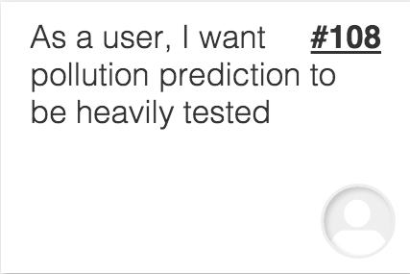
User stories
Airmazing
6 high-level user stories describing our goals
Broken down into 24 lower level user stories dealing with the implementation.
Stored in the product backlog on Mingle.

Slide 6
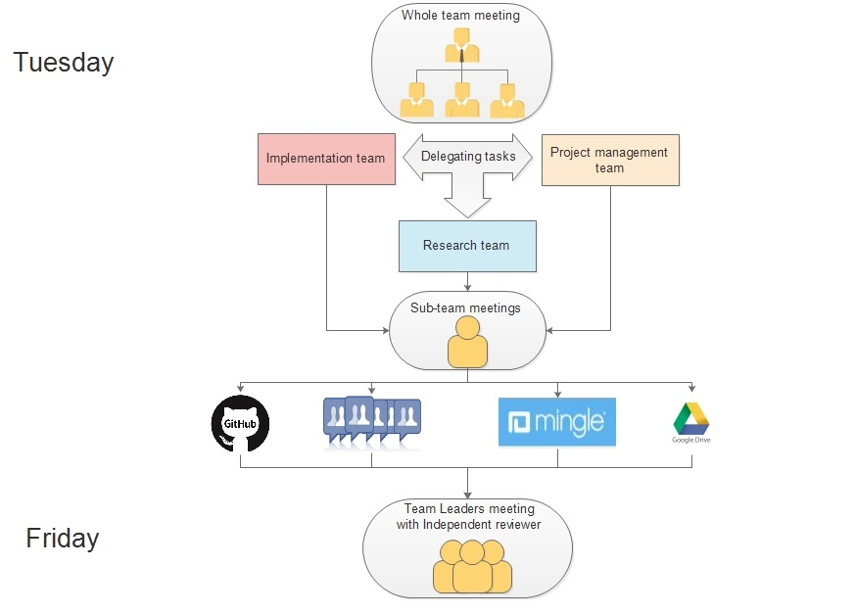
Communication Summary Diagram
Airmazing

Slide 7
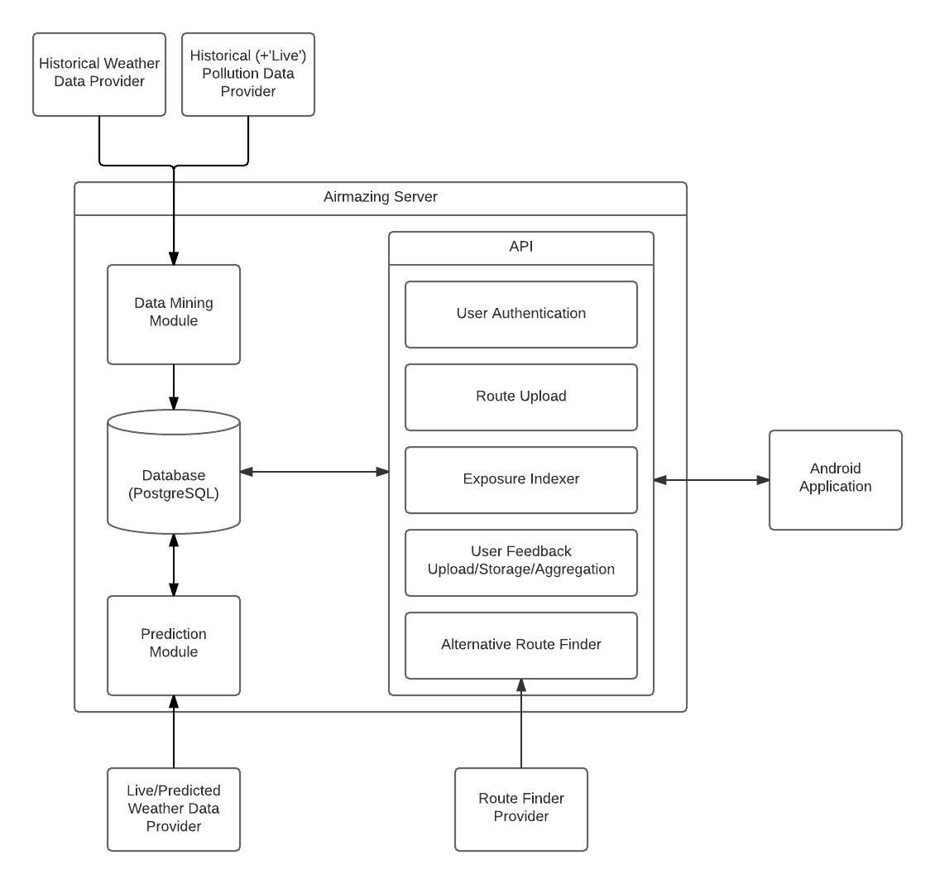
High Level Architecture
Airmazing

Slide 8
Appendix 1: High-level User Stories
Airmazing
As someone who travels to work, I want to be able to see the pollution levels for the next day so that I can plan my commute ahead of time.
As someone who travels to work, I want to see live pollution data in the morning so that I can make a decision about going into work.
As someone who puts importance into going to work everyday, I want to be able to find alternative routes with less pollution.
As someone who prefers not to spend time on apps, I want alerts to recommend whether I should stay at home or not so that I don’t have to determine this myself.
As someone who suffers from a respiratory disease, I want alerts and results that are tailored to me so that I can avoid exacerbating my condition.
As someone who struggles to understand data, I want a simple way of finding out the level of pollution I have been exposed to so that I don’t have to work it out myself.

